Slide 1
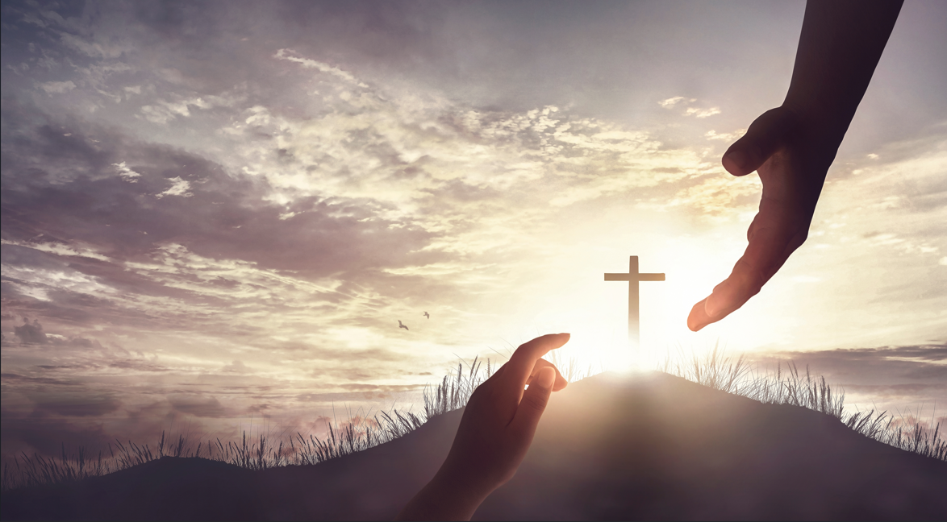
What is Christ’s Church First Love?
Revelation 2:1-4
Notes:
Eddie Williams ~ November 2, 2025

Slide 2
Revelation 2:1-4 (NAS)
¹ "To the angel of the church in Ephesus write: The One who holds the seven stars in His right hand, the One who walks among the seven golden lampstands, says this:

Slide 3
Revelation 2:1-4 (NAS)
² 'I know your deeds and your labor and perseverance, and that you cannot tolerate evil people, and you have put those who call themselves apostles to the test, and they are not, and you found them to be false;

Slide 4
Revelation 2:1-4 (NAS)
³ and you have perseverance and have endured on account of My name, and have not become weary.
⁴ 'But I have this against you, that you have left your first love.

Slide 5
The church at Ephesus left its first love, a concept explained in Revelation 2:4, meaning they lost the initial, fervent zeal and love for Jesus they had at the beginning of their faith.

Slide 6
While they were still orthodox, spiritual, and enduring, their actions became more about dutiful works and theological precision than a pure, passionate relationship with Christ.

Slide 7
Jesus warned them to repent, remember their first love, and do the works they did at first, or He would remove their lampstand.

Slide 8
The Accusation:
Jesus tells the Ephesian church, "I have this against you, that you have abandoned the love you had at first" (Revelation 2:4).

Slide 9
The Context:
The church was commendable for its hard work, endurance, discernment against false apostles, and intolerance of evil.

Slide 10
The Problem:
Their zeal for orthodoxy and good works had overshadowed their personal, passionate love for Jesus. They became self-sufficient, and their "love for Christ had diminished".

Slide 11
The Solution:
Jesus!

Slide 12
Jesus Urged Them to:
Remember: Reflect on the love they had at the beginning.
Repent: Change their ways and their mindset regarding their relationship with Christ.

Slide 13
Jesus Urged Them to:
Do the Works: Perform the actions they originally did to rekindle that love, such as seeking the lost, loving one another, worshipping, reading scripture, praying, and serving.

Slide 14
The Warning:
If they failed to repent, Jesus threatened to remove the church's lampstand, which represents its presence and impact.

Slide 15
Matthew 28:18-20 (KJV)
¹⁸ And Jesus came up and spoke to them, saying, "All authority in heaven and on earth has been given to Me. ¹⁹ "Go, therefore, and make disciples of all the nations, baptizing them in the name of the Father and the Son and the Holy Spirit,

Slide 16
Matthew 28:18-20 (KJV)
²⁰ teaching them to follow all that I commanded you; and behold, I am with you always, to the end of the age."

Slide 17
Acts 8:4 (NAS)
Therefore, those who had been scattered went through places preaching the word.

Slide 18
Acts 8:26-40 (KJV)
²⁶ And the angel of the Lord spake unto Philip, saying, Arise, and go toward the south unto the way that goeth down from Jerusalem unto Gaza, which is desert.

Slide 19
Acts 8:26-40 (KJV)
²⁷ And he arose and went: and, behold, a man of Ethiopia, an eunuch of great authority under Candace queen of the Ethiopians, who had the charge of all her treasure, and had come to Jerusalem for to worship,

Slide 20
Acts 8:26-40 (KJV)
²⁸ Was returning, and sitting in his chariot read Esaias the prophet.
²⁹ Then the Spirit said unto Philip, Go near, and join thyself to this chariot.

Slide 21
Acts 8:26-40 (KJV)
³⁰ And Philip ran thither to him, and heard him read the prophet Esaias, and said, Understandest thou what thou readest?
³¹ And he said, How can I, except some man should guide me?

Slide 22
Acts 8:26-40 (KJV)
And he desired Philip that he would come up and sit with him.
³² The place of the scripture which he read was this, He was led as a sheep to the slaughter; and like a lamb dumb before his shearer, so opened he not his mouth:

Slide 23
Acts 8:26-40 (KJV)
³³ In his humiliation his judgment was taken away: and who shall declare his generation? for his life is taken from the earth.
³⁴ And the eunuch answered Philip, and said, I pray thee, of whom speaketh the prophet this?

Slide 24
Acts 8:26-40 (KJV)
of himself, or of some other man?
³⁵ Then Philip opened his mouth, and began at the same scripture, and preached unto him Jesus.
³⁶ And as they went on their way, they came unto a certain water:

Slide 25
Acts 8:26-40 (KJV)
and the eunuch said, See, here is water; what doth hinder me to be baptized?
³⁷ And Philip said, If thou believest with all thine heart, thou mayest. And he answered and said, I believe that Jesus Christ is the Son of God.

Slide 26
Acts 8:26-40 (KJV)
³⁸ And he commanded the chariot to stand still: and they went down both into the water, both Philip and the eunuch; and he baptized him.

Slide 27
Acts 8:26-40 (KJV)
³⁹ And when they were come up out of the water, the Spirit of the Lord caught away Philip, that the eunuch saw him no more: and he went on his way rejoicing.

Slide 28
Acts 8:26-40 (KJV)
⁴⁰ But Philip was found at Azotus: and passing through he preached in all the cities, till he came to Caesarea.

Slide 29

…that Christ died for our sins according to the scriptures; And that he was buried, and that he rose again the third day according to the scriptures:

Slide 30
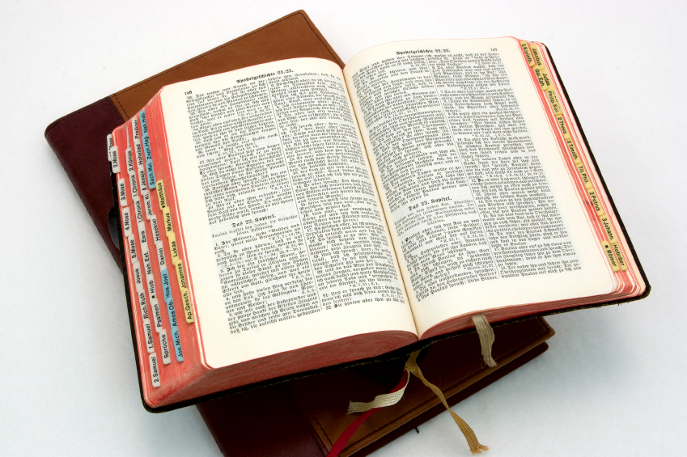
Hear: Romans 10:17
So then faith cometh by hearing, and hearing by the word of God.

Slide 31
Believe: Hebrews 11:6
But without faith it is impossible to please him: for he that cometh to God must believe that he is, and that he is a rewarder of them that diligently seek him.

Slide 32
Repent: Luke 13:3
I tell you, Nay: but, except ye repent, ye shall all likewise perish.

Slide 33
Confess: Matthew 10:32-33
32 Whosoever therefore shall confess me before men, him will I confess also before my Father which is in heaven.
33 But whosoever shall deny me before men, him will I also deny before my Father which is in heaven.

Slide 34
Baptize: Acts 22:16
And now why tarriest thou? arise, and be baptized, and wash away thy sins, calling on the name of the Lord.

